Slide 1
Introducing the operating system
Middleman between user (and her apps) and the hardware
“User” is not necessarily a human
“A collection of computer programs that integrate the hardware resources of the computer and make those resources available to a user and the user’s programs, in a way that allows the user access to the computer in a productive, timely, and efficient manner.”
“Master program”
Memory resident portion – kernel
Supplementary programs
Windows, Mac OS, Linux/Unix
*
IT520 Operating Systems
‹#›

Slide 2
Computer Purpose
The main purpose of a computer is to run a predefined sequence of instructions, known as a program.
A program under execution is often referred to as a process.
Now, most computers are meant to run a single process, but in a sophisticated system such a general purpose computer, are intended to run many processes simultaneously.
Any kind of process requires hardware resources such are Memory, Processor time, Storage space, etc.

Slide 3
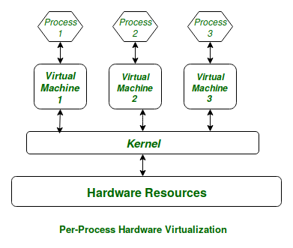
Kernel
In a Von Neumann Computer running many processes simultaneously, we need a middle layer to manage the distribution of the hardware resources of the computer efficiently and fairly among all the various processes running on the computer.
This middle layer is referred to as the kernel.
Basically the kernel virtualizes the common hardware resources of the computer to provide each process with its own virtual resources. This makes the process seem as it is the sole process running on the machine.
The kernel is also responsible for preventing and mitigating conflicts between different processes.

Slide 4
OS services
User interface
Application programming interface (API)
File management
Process management
Initial program load (IPL)
Interrupt servicing
Network interface
Hardware management
Security
System administration
*
IT520 Operating Systems
‹#›

Slide 5
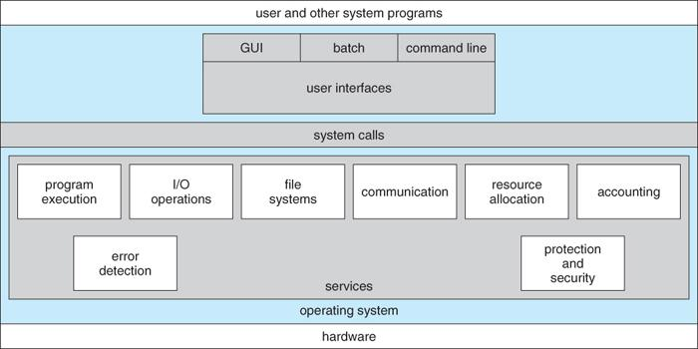
A View of OS Services
*
IT520 Operating Systems
‹#›

Slide 6
OS Configurations
Three main configurations for the organization of an operating system
Monolithic configuration
Unix/Linux
Hierarchical (layered) configuration
Multics
Windows 2000 and later versions (approximately hierarchical)
Microkernel
Macintosh OS X

Slide 7
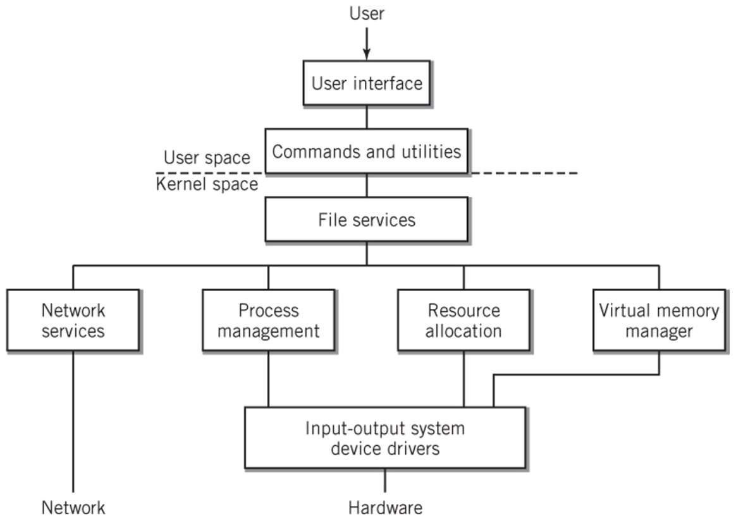
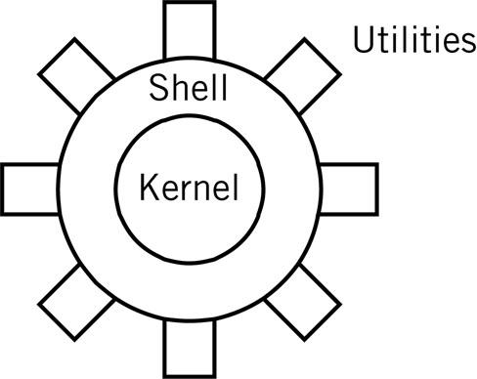
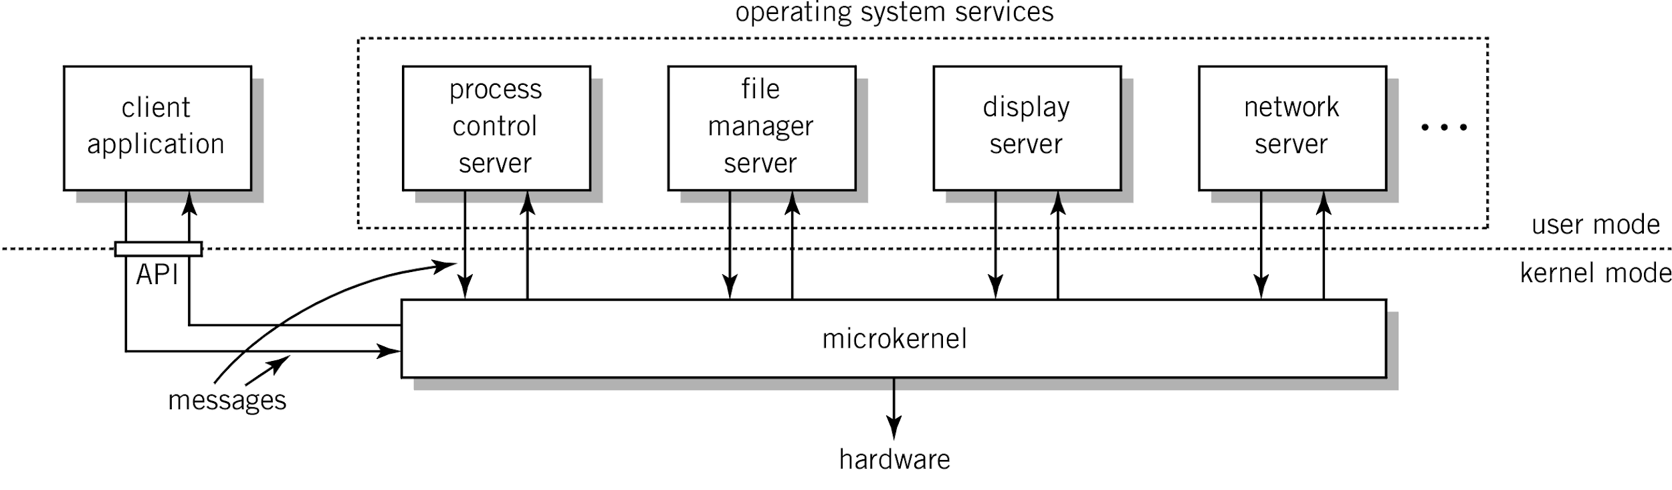
Organization
*
‹#›

Slide 8
Monolithic Kernel
Drawback: stability and integrity must be managed carefully
Examples: UNIX, Linux
Copyright 2010 John Wiley & Sons, Inc.
15-‹#›

Slide 9

Hierarchical Model of an OS
Each layer is independent of the other layers
Requests are passed down to the layer immediately below it
Copyright 2010 John Wiley & Sons, Inc.
15-‹#›

Slide 10
Microkernel
Minimum essential functionality
Client-server system on same system
Clients request services from microkernel which passes message onto appropriate server
Copyright 2010 John Wiley & Sons, Inc.
15-‹#›

Slide 11
Types of operating systems
Single-user
Mainframe
Network server
Mobile
Real-time
Embedded control
Distributed
*
IT520 Operating Systems
‹#›

Slide 12
7 Types of Operating Systems
Single-user systems and workstations
Predominant systems in use
Macintosh OSX, versions of Windows, Linux and Sun Solaris
Mainframe systems
Designed to manage large scale computing resources
Extensive I/O capability to handle large numbers of transactions
Support batch data processing operations
Consist of clusters made up of multiprocessor units
Network servers
Focused on supporting clients connected to the server
Improved security, high reliability, backup facilities
Copyright 2010 John Wiley & Sons, Inc.
15-‹#›

Slide 13
7 Types of Operating Systems
Mobile operating systems
Designed for small hand-held devices such as tablets and smart phones
Features of single-user multitasking systems but with constraints on memory, storage, CPU execution speed and electrical power
Special keyboard handling
Real-time systems
One or more processes must be able to access the operating system immediately
Multitasking system where the real-time program’s interrupts have very high priority
Examples
Air controller systems, rocket propulsion control systems, car brakes
Copyright 2010 John Wiley & Sons, Inc.
15-‹#›

Slide 14
7 Types of Operating Systems
Embedded control systems
Specialized systems designed to control a single piece of equipment such as an automobile or a microwave oven
Software is usually provided in ROM
Real-time system dedicated to the particular application
Example: General Motors Delphi system
Distributed systems
Processing power distributed among computers in a cluster or network
Example: Distributed Computing Environment (DCE)
Copyright 2010 John Wiley & Sons, Inc.
15-‹#›

Slide 15
User interfaces
Command line interface – CLI
Text only input, primarily textual output
Graphical user interface – GUI
Text and spatial input, textual and graphical output
*
IT520 Operating Systems
‹#›

Slide 16
System Call
In computing, a system call is the programmatic way in which a computer program requests a service from the kernel of the operating system it is executed on.
A system call is a way for programs to interact with the operating system. A computer program makes a system call when it makes a request to the operating system’s kernel.
System call provides the services of the operating system to the user programs via Application Program Interface(API). It provides an interface between a process and operating system to allow user-level processes to request services of the operating system.
System calls are the only entry points into the kernel system. All programs needing resources must use system calls.

Slide 17
Services provided by System Calls
Process creation and management
Main memory management
File Access, Directory and File system management
Device handling(I/O)
Protection
Networking, etc.

Slide 18
Types of System Calls
There are 5 different categories of system calls –
Process control: end, abort, create, terminate, allocate and free memory.
File management: create, open, close, delete, read file etc.
Device management
Information maintenance
Communication

Slide 19
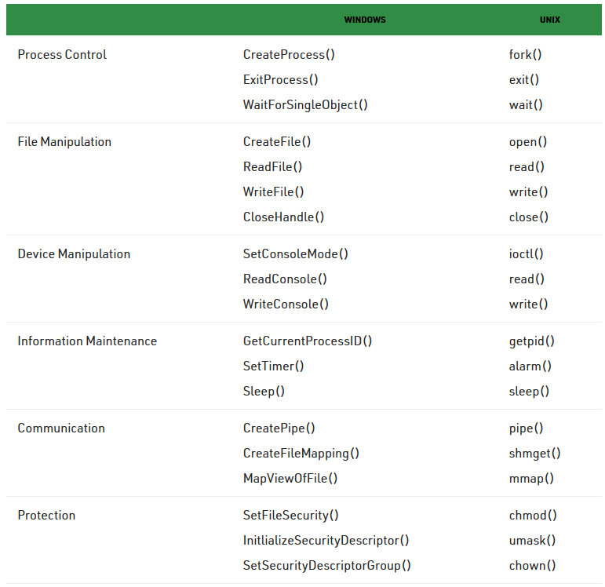
Examples of Windows and Unix System Calls

Slide 20
File management
Files and folders/directories – logical storage
Sequential vs. random vs. indexed access
Hard disks, flash drives, etc. – physical storage
File manager maps one to the other
File and folder names
Folder contents
Allocates and tracks blocks – FAT
Hides details and provides user with a consistent logical view of stored data
*
IT520 Operating Systems
‹#›

Slide 21
Physical file storage
Blocks – accessible in-place
3 common methods of storage allocation
Contiguous
Simple, but difficult to predict file’s future requirements
Fragmentation
Noncontiguous
Linked – File Allocation Table (FAT)
Indexed – i-node and NT File System (NTFS)
*
IT520 Operating Systems
‹#›

Slide 22
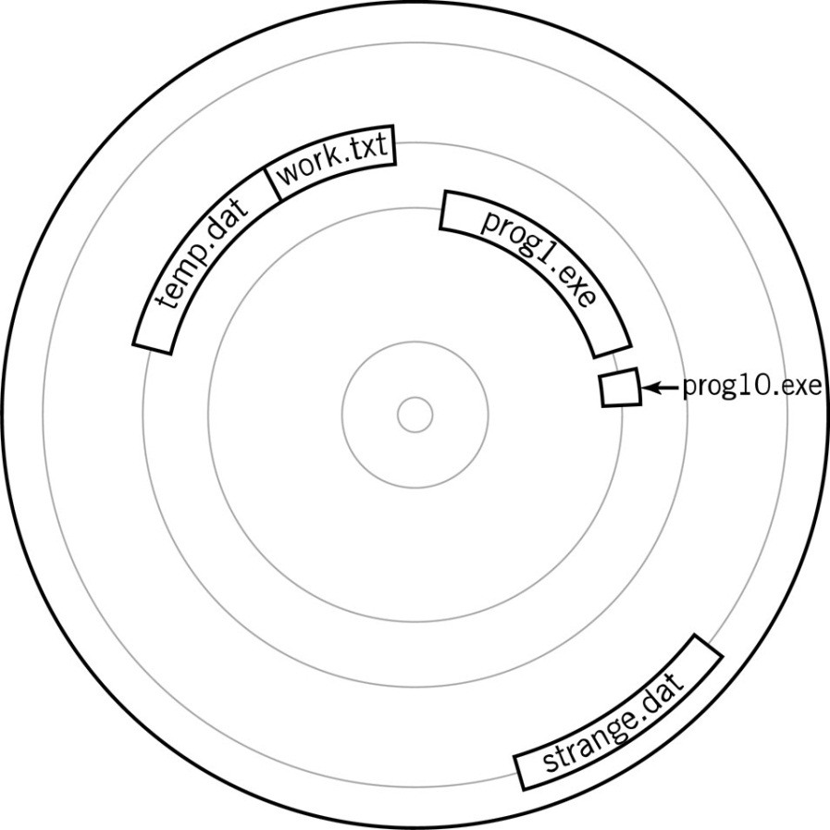
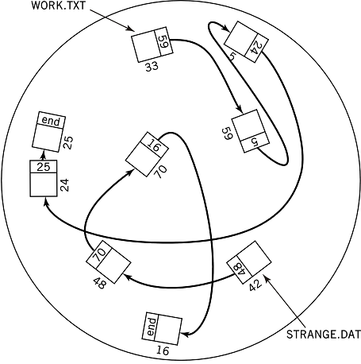
File Allocation
Contiguous Storage Allocation
Linked Allocation
Chapter 17 File Management
17-‹#›

Slide 23
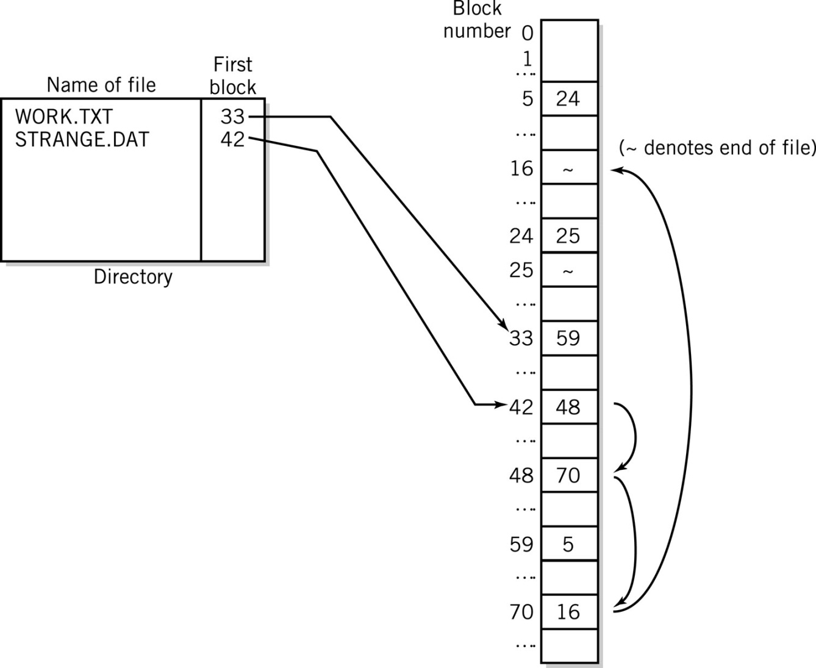
File Allocation Table
Linked Allocation and File Allocation Table
Chapter 17 File Management
17-‹#›

Slide 24
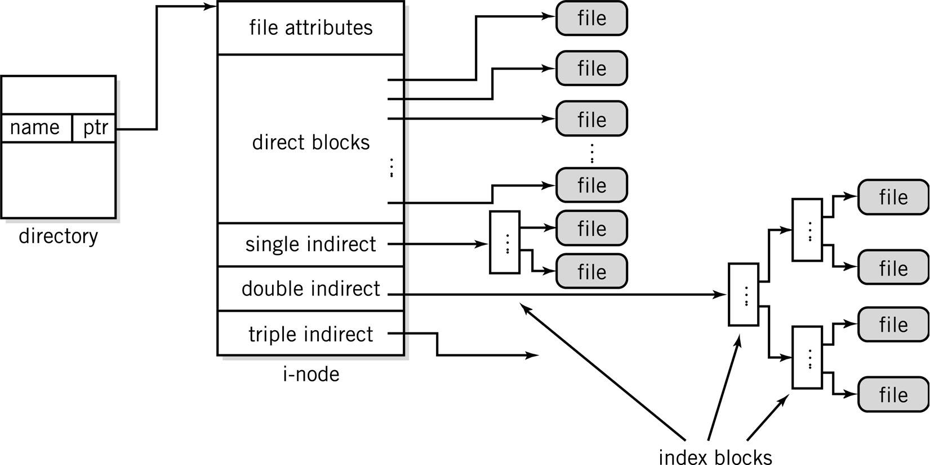
Unix i-nodes
17-‹#›

Slide 25
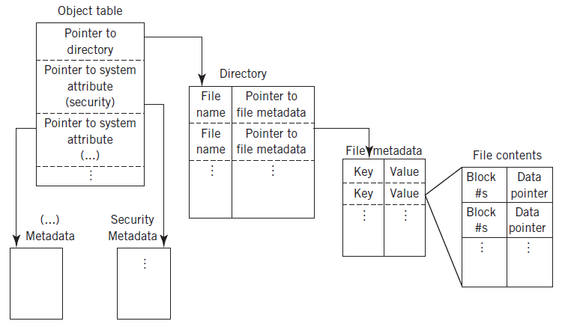
Microsoft Resilient File System (ReFS)
Copyright 2013 John Wiley & Sons, Inc.
17-‹#›

Slide 26
I/O services
Device drivers
Support OS components and applications
Basic Input/Output System (BIOS)
Modular approach
Manual vs. automatic installation
Plug-and-play
OS manages access and prevents conflicts
*
IT520 Operating Systems
‹#›

Slide 27
Process control management
Process = executing program + resources
Fundamental unit of work
System process vs. user process
Forking – parent and child
Process vs. thread
*
IT520 Operating Systems
‹#›

Slide 28
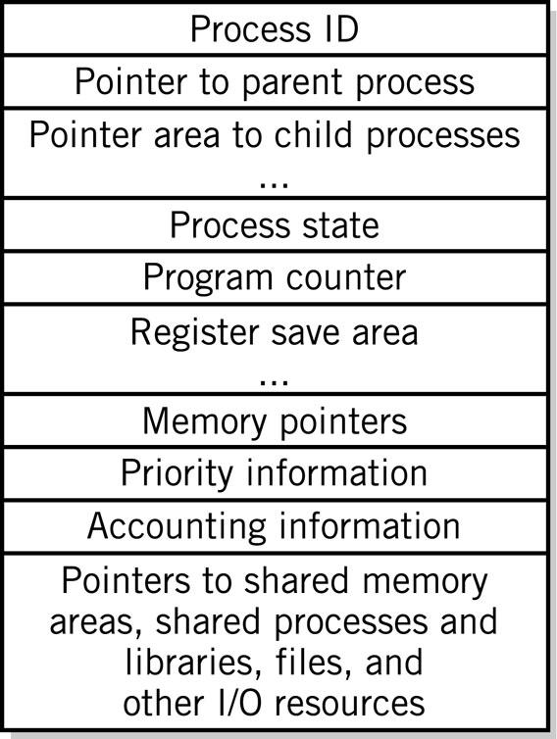
Process Control Block
A block of data for each process in the system
Contains all relevant information about the process
Typical process control block on the right 🡪
Copyright 2013 John Wiley & Sons, Inc.
18-‹#›

Slide 29
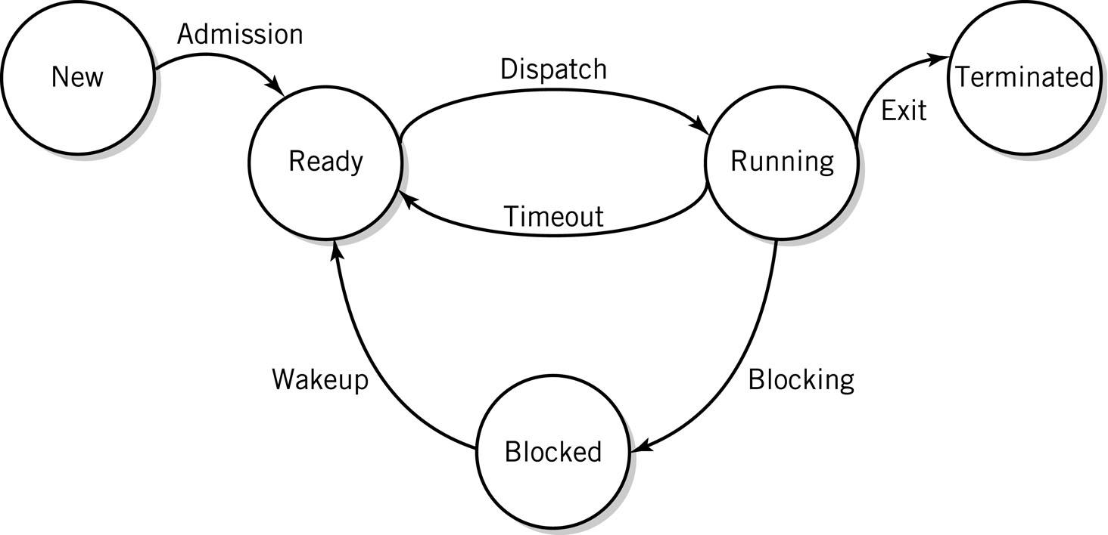
Process states
*
IT520 Operating Systems
‹#›

Slide 30
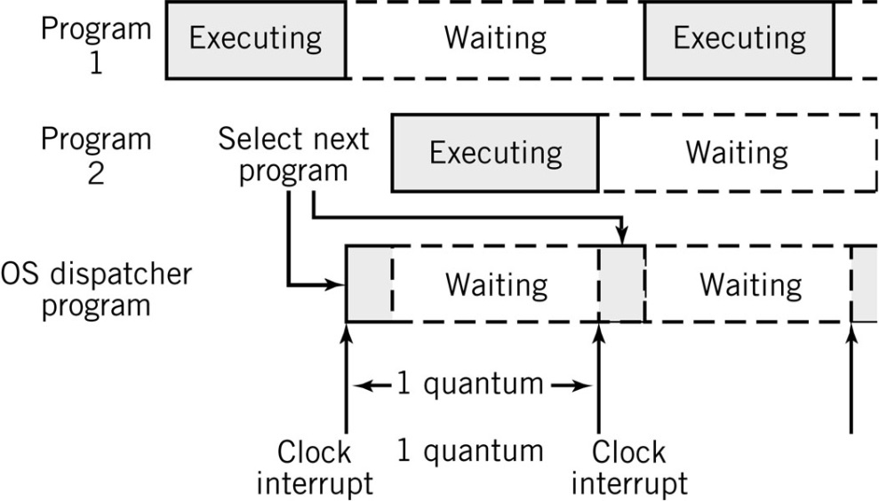
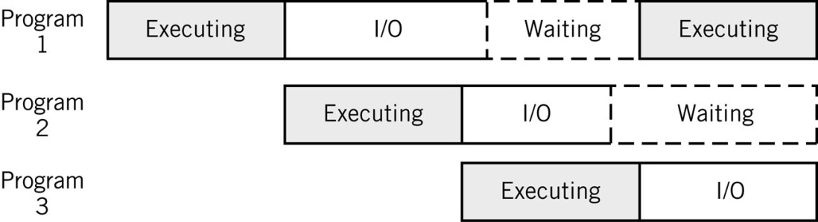
Scheduling and dispatch
Fair and efficient use of CPU time
High-level scheduling
Dispatching
Context-switching
Starvation
*
IT520 Operating Systems
‹#›

Slide 31
Dispatching Objectives
Ensure Fairness
Maximize throughput
Minimize turnaround time
Maximize CPU utilization
Maximize resource allocation
Promote graceful degradation
Provide minimal and consistent response time
Prevent starvation
Copyright 2010 John Wiley & Sons, Inc.
18-‹#›

Slide 32
Dispatch algorithms
Nonpreemptive
First-in, first-out (FIFO)
Shortest job first (SJF)
Priority scheduling
Preemptive
Round robin
Multilevel feedback queues
Dynamic priority scheduling
*
IT520 Operating Systems
‹#›

Slide 33
Nonpreemptive Dispatching
First in, first out (FIFO)
Unfair to short processes and I/O based processes
Shortest Job First (SJF)
Longer jobs can be starved
Priority Scheduling
Job with the highest priority is selected
If multiple jobs have the highest priority then dispatcher selects among them using FIFO
Copyright 2010 John Wiley & Sons, Inc.
18-‹#›

Slide 34
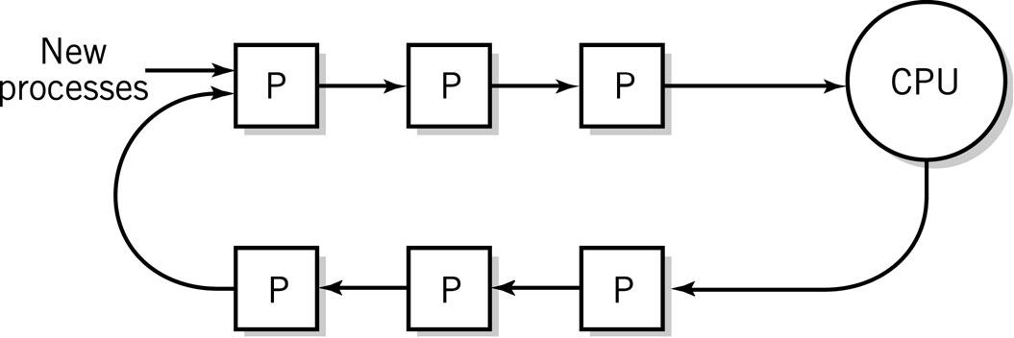
Preemptive Dispatching
Round robin
Inherently fair and maximizes throughput
Dynamic Priority
Based on ratio of CPU time to total time process has been in the system
Smallest ratio has highest priority
Linux; Windows 2000, XP, Vista, 7
Copyright 2010 John Wiley & Sons, Inc.
18-‹#›

Slide 35
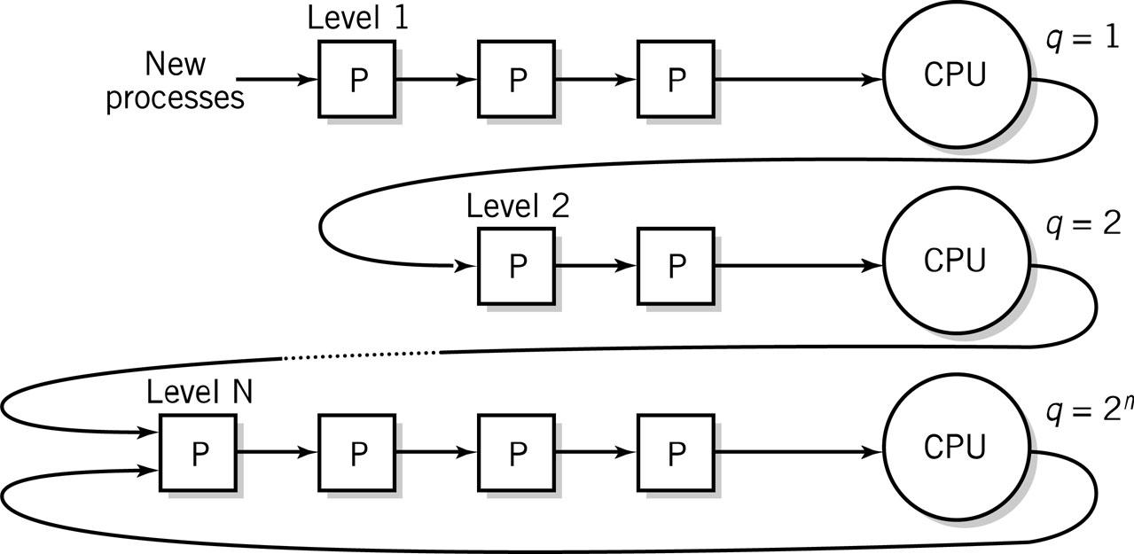
Preemptive Dispatching
Multilevel feedback queues
Favors short jobs, I/O bound jobs
Each level assigns more CPU time
Copyright 2010 John Wiley & Sons, Inc.
18-‹#›

Slide 36
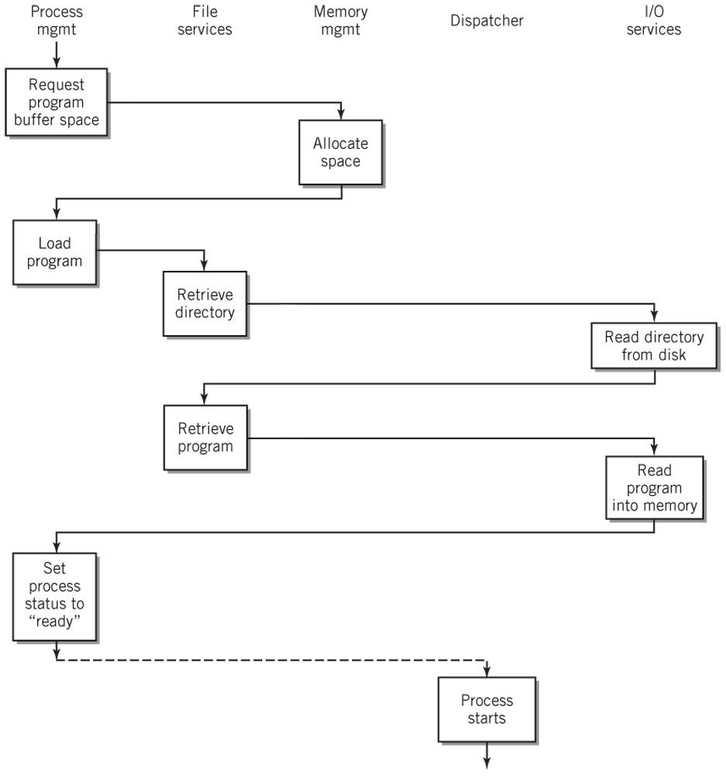
Loading and Executing a Process
Copyright 2010 John Wiley & Sons, Inc.
18-‹#›

Slide 37
Memory management
Three essential tasks
Tracks, allocates and monitors memory
Manages waiting processes
Recovers resources
Virtual memory
Frames and offsets
Pages and logical addresses
Dynamic address translation (DAT)
Page tables
Swap file/backing store
Page faults and page swapping
Thrashing
*
IT520 Operating Systems
‹#›

Slide 38
Virtual Memory – Basic Ideas
Virtual memory increases the apparent amount of memory by using far less expensive hard disk space
Provides for process separation
Demand paging
Pages reside on hard disk and are brought into memory as needed
Page table
Keeps track of what is in memory and what is still out on hard disk
Copyright 2010 John Wiley & Sons, Inc.
18-‹#›

Slide 39
Pages and Frames (1)
 | Program | Memory
Unit | Page | Frame
Address | Logical | Physical
Size | 2 to 4KB | 2 to 4KB
Amount | # of bits in instruction word | Installed memory
Copyright 2010 John Wiley & Sons, Inc.
18-‹#›

Slide 40
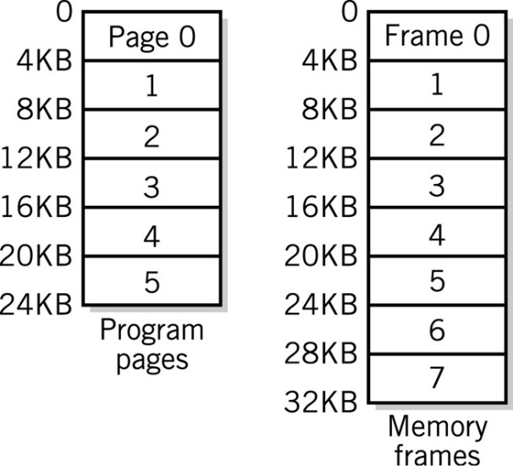
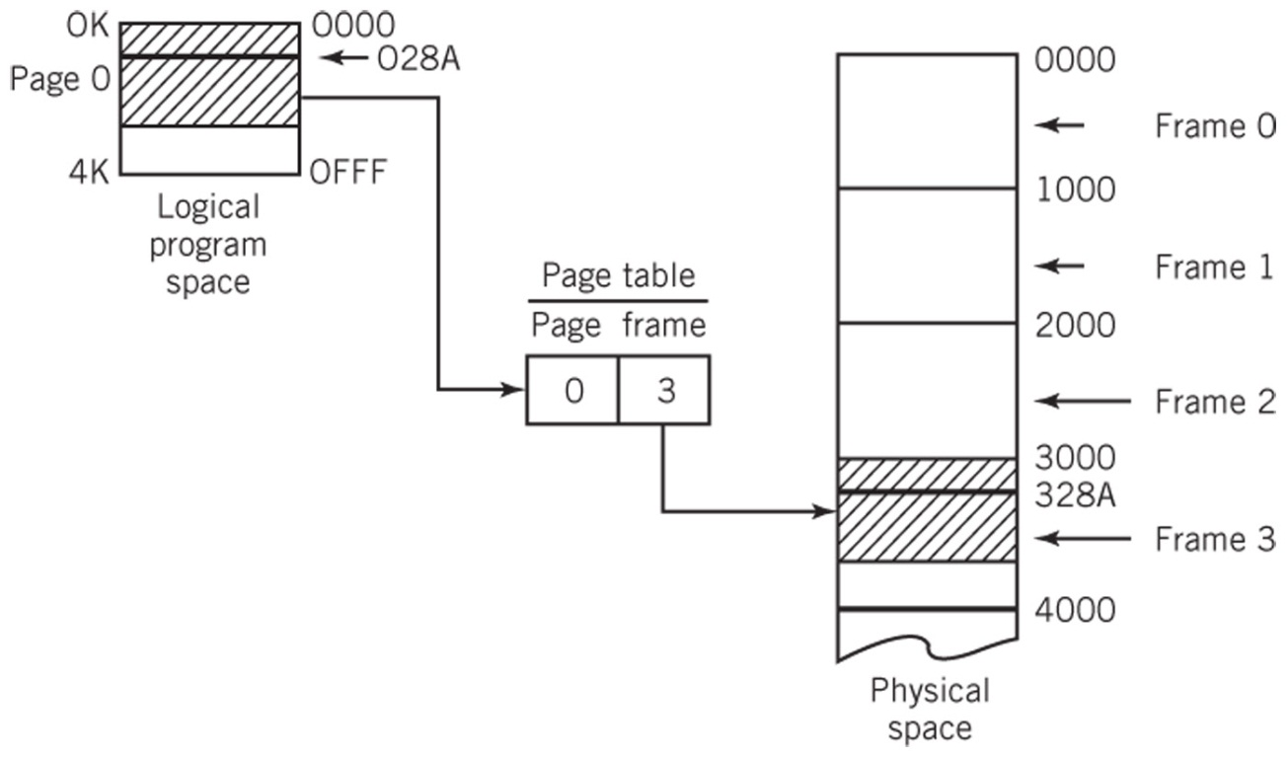
Pages and Frames (2)
Pages and Frames
A Simple Page Table Translation
Each program has its collection of pages.
The total number of pages can exceed the number of frames (physical memory).
Copyright 2010 John Wiley & Sons, Inc.
18-‹#›

Slide 41
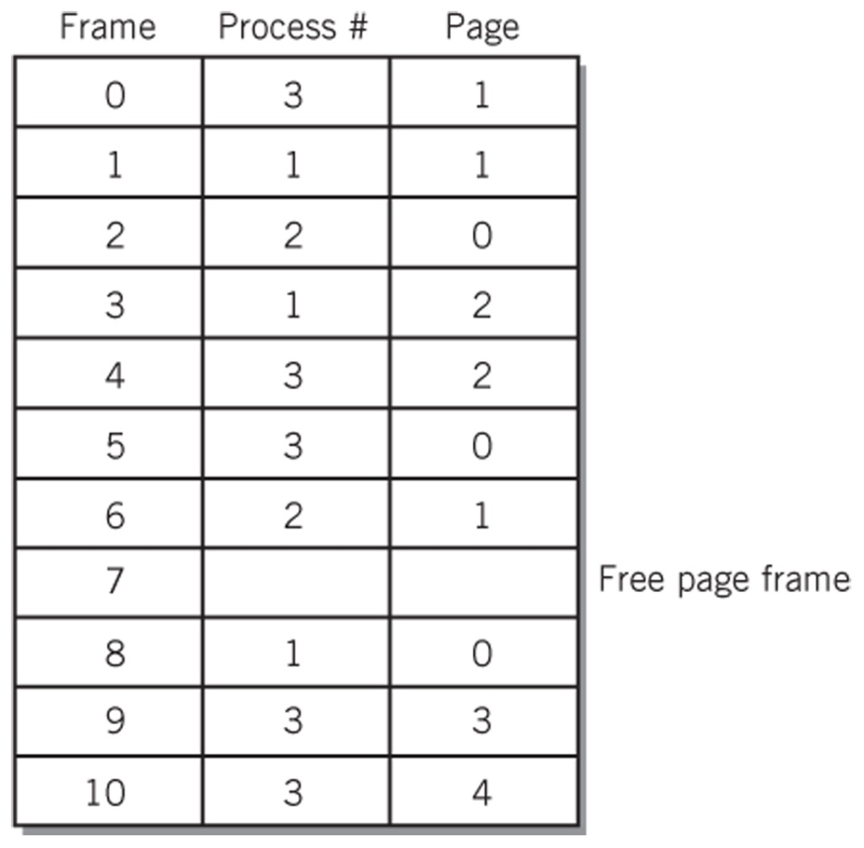
Inverted Page Table
Inverted Page Table for the previous slide
The table represents what is in physical memory
Copyright 2010 John Wiley & Sons, Inc.
18-‹#›

Slide 42
Page Replacement Algorithms
Page fault
Page is not in memory and must be loaded from disk
Algorithms to manage swapping
FIFO – First-In, First-Out
Belady’s Anomaly – when increasing number of pages results in more page faults
LRU – Least Recently Used
NUR – Not Used Recently
Referenced bit
Modified (dirty) bit
Second Chance Replacement algorithms
Thrashing
Too many page faults affect system performance
Copyright 2013 John Wiley & Sons, Inc.
18-‹#›

Slide 43
Virtual Memory Tradeoffs
Disadvantages
SWAP file takes up space on disk
Paging takes up resources of the CPU
Latency could be an issue
Advantages
Programs share memory space
More programs run at the same time
Programs run even if they cannot fit into memory all at once
Process separation
Copyright 2013 John Wiley & Sons, Inc.
18-‹#›

Slide 44
Secondary storage management
Fair and efficient use of secondary storage
Managing seek time
Scheduling
First-come, first-served (FCFS)
Shortest distance first (SDF)
Scan
N-step C-scan
*
IT520 Operating Systems
‹#›

Slide 45
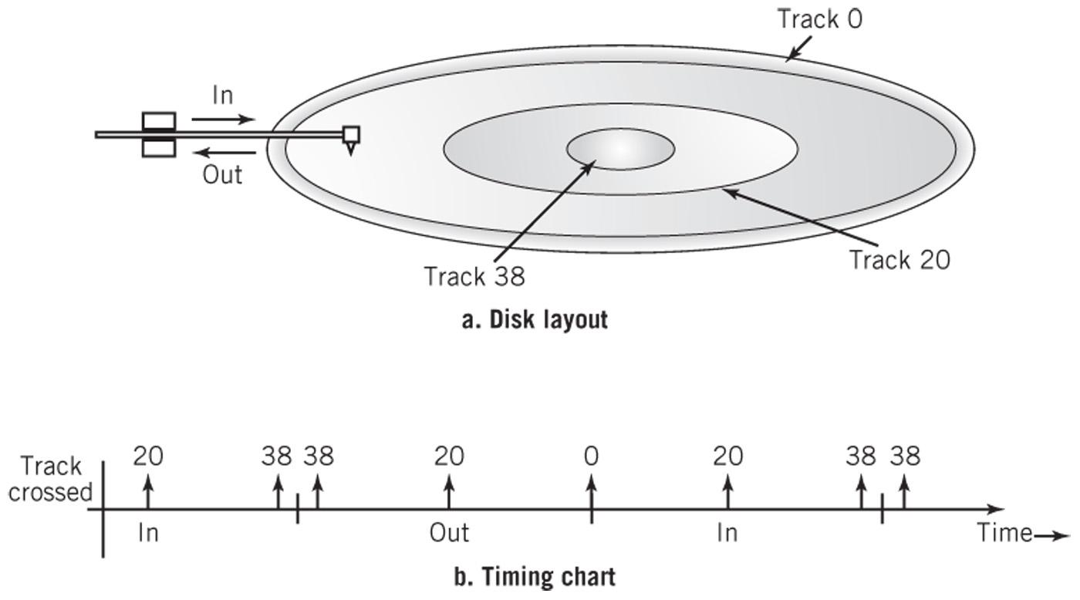
Scan Scheduling Algorithm
Copyright 2010 John Wiley & Sons, Inc.
18-‹#›

Slide 46
Communications support services
Allow participation in a network
TCP/IP protocol suite
Virtual private network (VPN)
Clustering support
System scalability
Fail-safe operation
*
IT520 Operating Systems
‹#›

Slide 47
Security services
Protect system from processes
Protect processes from other processes
Protect processes from outside world
Processes limited to instructions and data in their allocated memory
Everything else accessed via the OS
Allows OS to monitor and control access
Access control
Login
Permissions
Firewalls
*
IT520 Operating Systems
‹#›

Slide 48
System administration support
System administrator (sysadmin)
Configures system
System generation (sysgen)
Manages user accounts
Ensures security
Manages file systems and backups
Manages network interfaces
Installs, upgrades and monitors software
Keeps OS up-to-date
Optimizes and upgrades system for peak performance
User-administrated OSes hide the details
OSes with a dedicated sysadmin provide support programs to facilitate common tasks
*
IT520 Operating Systems
‹#›

